Slide 1
Importance of news
To inform, enlighten, educate, engage the populace

Slide 2
Things to keep in mind about journalism
Journalism is not the same thing as “media”
Mainstream news sources (national newspapers, in particular) report truth, not bias.
Journalists tell important stories, expose corruption

Slide 3
Writing news
Writing information in an interesting story

Slide 4
Concise
Informative
Interesting
Be concise but comprehensive Short sentences (as they need to be)| Necessary information
Use conversational words Varied sentence length (max 30; simple > complex) Write in third person (keeps it more objective)
Inform … but be Interesting Emphasize the “what happened” or “who did what” Put the “when” and “where” at middle or end
Use facts from trustworthy sources Give source of info/person saying quote (attribution)
Inverted pyramid format****
the Trifecta
for writing well

Slide 5
“Inverted pyramid” - overview
“Report the Score”
Highlight the “news” (what happened/the outcome)
What is the latest development in an ongoing story?
What was the most interesting comment from a discussion or speech?
What action was taken (vote?)
Focus on what is most important/interesting first
Write in past tense and third person
ONE SENTENCE in EACH PARAGRAPH
Use LOGIC of information to determine what facts are told next, and next, and next.

Slide 6
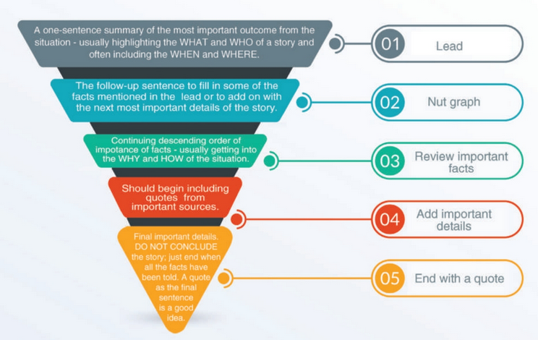
“Inverted pyramid”
descending order of importance

Slide 7
Lead + ‘nut graph’ = most important info
A bull shark bit a local resident in the leg while she was swimming about 60 yards off the beach at Sullivan’s Island yesterday.
Nela Rhodes, 35, was swimming near Station 24 around 6 p.m. Tuesday when a shark with a grey tip bit her, according to the Sullivan’s Island Police Department.
Lead >>>
Highlight the more important information in the story.
Nut graph >>>
Fill in important facts mentioned in the lead OR move on to the next most important fact. This example fills in some details from facts mentioned in the lead.

Slide 8
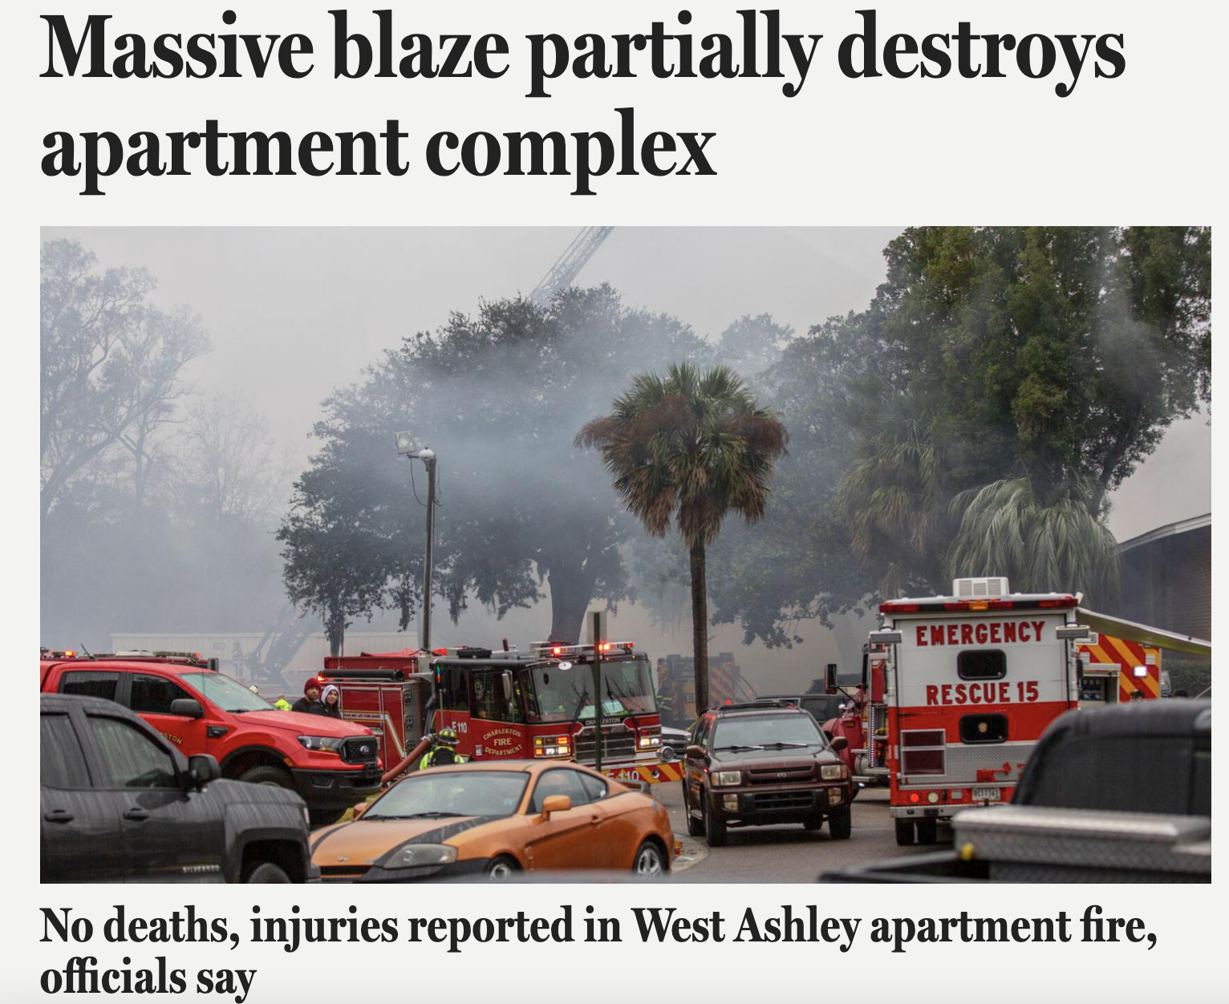
Example lead from P&C
Around 100 firefighters from Charleston, North Charleston and St. Andrews departments descended on an apartment complex West of the Ashley to battle an early morning fire that displaced 179 people from their homes.
*An early morning fire at a West Ashley apartment complex displaced more than 179 people as 100 firefighters from three municipal fire departments fought the unruly blaze.
The fire destroyed five buildings and wiped out 56 apartments. But there were no deaths or serious injuries reported in the unruly blaze.
There were no deaths or serious injuries, but the fire destroyed five buildings and wiped out 56 apartments.

Slide 9
Direct v. Delayed LEAD
Example (delayed):
During this year’s Super Bowl, you can expect to see flashy, expensive ads rom all the usual suspects: Budweiser, Pepsi, Lays, BMW and more.
What you won’t see advertised during the big game, though, is cannabis.
Because NBC, the network broadcasting Super Bowl LVI rejected a 30-second spot promoting the benefits of medical marijuana, saying it does “not currently accept cannabis-related advertising.”
Direct lead - state the main point of the article up front:
Delayed lead - delay the main “info” to the second or third sentence in order to have a more creative open to draw readers in.
Example (direct):
NBC announced it will not accept cannibis-related advertising during the Super Bowl, turning away more than $20 million in revenue.

Slide 10
“Inverted pyramid” - the story
Charleston firefighters were dispatched to the Palms Apartments off Orange Grove Road just before 5 a.m. Feb. 7. A resident had dialed 911 to report smoke in the hallway, Chief Fire Marshal Mike Julazadeh said.
The three-alarm fire originated inside a unit at 220 Royal Palm Blvd., he said.
The large complex, which was built in 1966, contains 52 separate buildings and 408 total apartments.
“Five buildings is a lot but we were fortunate to contain the blaze before it engulfed the entire property,” Julazadeh said. “And we were even more fortunate to have no serious injuries.”
“Continue the game”
Continue the story by what is the NEXT most important or interesting fact.
Transition with LOGIC - what info should come next?
What quotes help confirm the information, add life to the story?

Slide 11
“Inverted pyramid” - the end
Residents living in 32 dwellings were also displaced due to loss of power and water in addition to the 56 apartments destroyed.
The fire spread across seven buildings total. Five of those interconnected buildings were destroyed, according to the department. The other two buildings received substantial damage, authorities said.
Julazadeh said the town would find temporary housing for those displaced who didn’t have other options for temporary housing.
“It will be six to eight months before anyone can live in these buildings,” he added.
“Finish the last point”
Avoid speech introduction/ cheerleader-type endings,
Don’t introduce something new
Quotes are great final sentences - like ending a conversation.

Slide 12
DO NOT...
Write in chronological order - most important info first
Start sentences with the WHEN info. (“On Jan. 30…”)
Have long sentences (20-25 words is best)
Have more than one sentence per paragraph
Include any opinion, assessment, evaluation
*DO NOT Overwrite.
Write direct and simple sentence structure for most sentences (subject, verb, object).
For variety and rhythm, vary the length and type of sentence - mix short, direct sentences with complex ones:
dependent clauses, prepositional phrases, conjunctions

Slide 13
how to write QUOTES

Slide 14
Quotes
Put attribution AT THE END OR MIDDLE of the quote
Punctuation ALWAYS GOES INSIDE quote marks
Use “SAID” almost always (occasionally can use “added” “pointed out” “noted” because they are neutral.
**Quote ONLY INTERESTING comments – things that express reaction, opinion, emotion, analysis from the source.

Slide 15
DO NOT...
Grant Riller said, “I didn’t see that coming but that didn’t really bother me. But after Banks punched Brevin, I wasn’t going to let that go. I knew they were fired up after losing a close game at the last second, so we’ve got to keep from letting their emotions get to us. We’re on a good run here and need to stay focused to try and get back into the conference lead. I should have done more to control it.”
Put attribution
in front of the quote

Slide 16
Instead...
“I didn’t see that coming but that didn’t really bother me. But after Banks punched Brevin, I wasn’t going to let that go. I knew they were fired up after losing a close game at the last second, so we’ve got to keep from letting their emotions get to us,” said CofC guard Grant Riller. “We’re on a good run here and need to stay focused to try and get back into the conference lead. I should have done more to control it.”
Put attribution
in the middle
or at the end

Slide 17
Or even better...
Cougars point guard Grant Riller said he didn’t like that Banks punched Galloway but acknowledged that he and his teammates have to control their actions better.
“I knew they were fired up after losing a close game at the last second, so we’ve got to keep from letting their emotions get to us,” Riller said. “We’re on a good run here and need to stay focused to try and get back into the conference lead. I should have done more to control it.”
Paraphrase some substance from the quote to write a “lead-in” sentence (separate sentence, separate paragraph) and then end with a short quote of the best part.

Slide 18
Basic rules for writing a headline (not a title!)
Focus on the main news of the story
Aim for specific and attention-getting VERBS
Don’t use articles (“a” “an” “the”)
Use commas instead of “and”
Can always use the numeral for a number reference
Use single quotes instead of double
Do NOT capitalize every word - just first word and proper nouns
Example:
Russia, Hong Kong place travel restrictions on China; reports show ‘more than 1,000 infected’ with coronavirus

Slide 19
Promoting news on social media
Follow same Trifecta principles with tweet, status update, Instagram post:
Concise, Informative, Interesting
Never re-write the headline as the tweet or post.
Tag people, places as much as possible (w/o overdoing it)
Remember the goal - to get people to click on the story, so make it enticing but not “clickbait”

Slide 20
